Slide 1



HOTEL WEBSITE

Slide 2

ABOUT
US
私たちに関しては
1

Slide 3


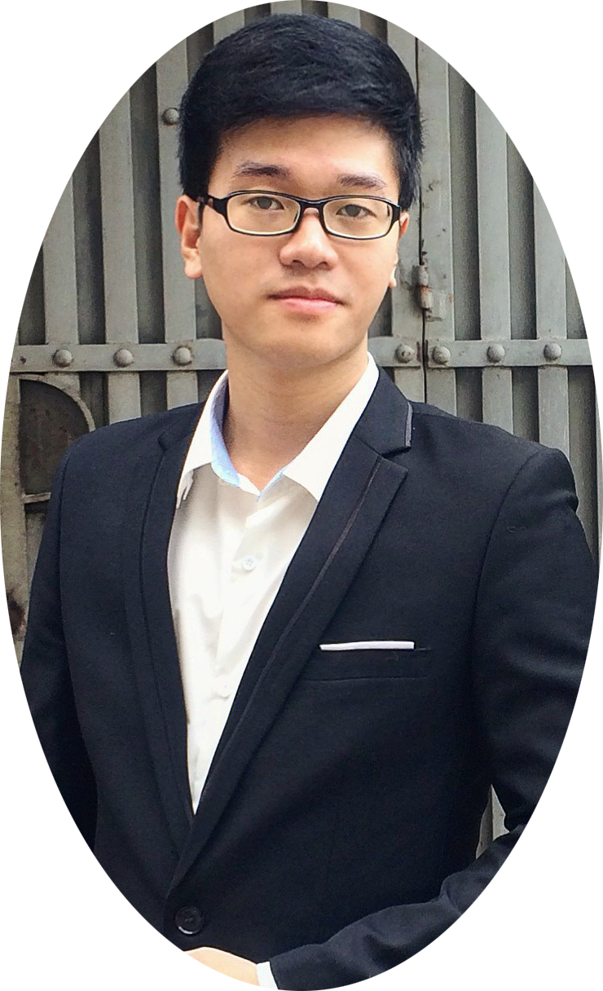
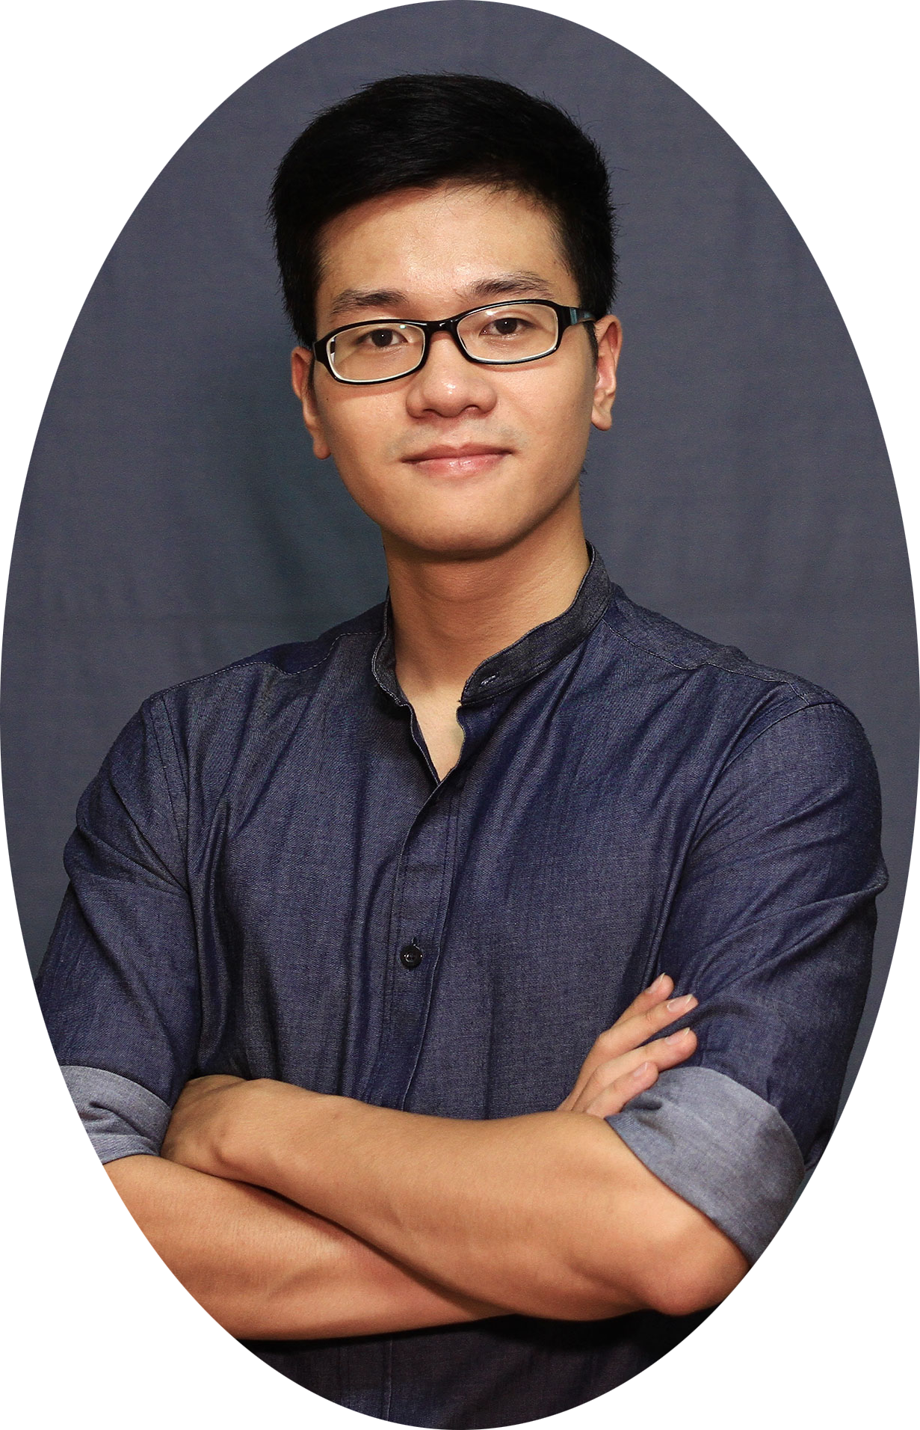
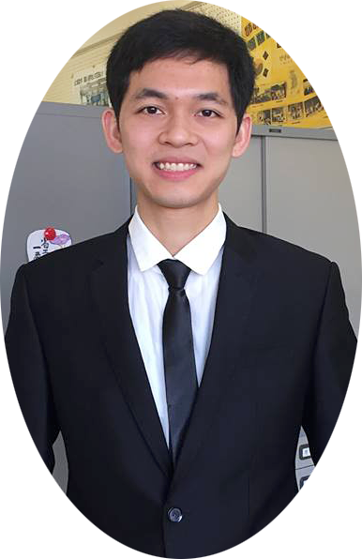
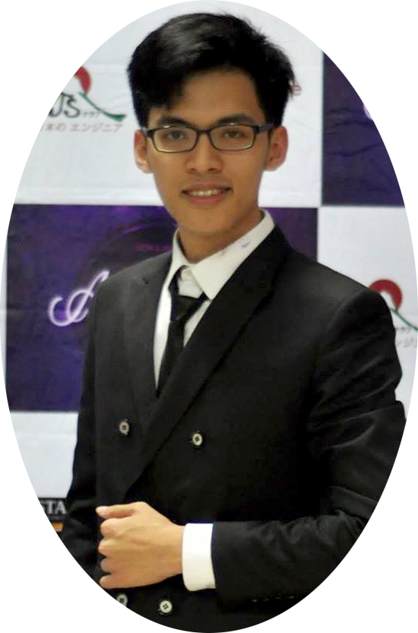
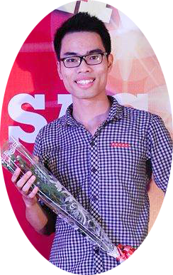
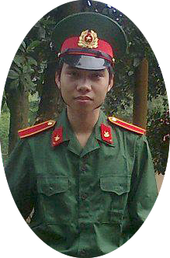
ABOUT US
Vu Tran Hoang
Team Member
Tran Ba Quyen
Team Member
Nguyen Viet Hung
Team Leader
- HOWE Team -
We are final year students of FPT University. With the tutorial of Mr.Phan Truong Lam,
we had successfully built this project
Dang Cong Son
Team Member
Dang Duc Manh
Team Member
2

Slide 4

Q & A - 質問と回答
Outlines
アウトライン
8
Demo - デモ
7
6
Lesson Learned
教訓
Software Testing
ソフトウェアテスト
5
Software Design Description
ソフトウェア 設計書
4
3
Software Requirement Specification
ソフトウェア要件仕様書
2
Software Project Management
プロジェクト管理
1
Background バックグラウンド
3

Slide 5
BACKGROUND
バックグラウンド
4

Slide 6
Background
バックグラウンド
First 3 months of 2017:
The total number of tourists to Quangninh was about 3,769 million people, up 12% over the same period of 2016.
The number of tourists to Halong Bay was about 928,900 people.
The higher the number of tourists is, the greater the demand for accommodation and hotel services increases, resulting in the establishment of more hotels.
Hotels face with difficulties in:
Booking.
Room services managing.
Using tools for management.
5

Slide 7

Background
バックグラウンド
Idea
Develop a website to:
Brand the hotel’s image.
Offer customers with a time-saving and efficient booking way
Provide favorable tool for the hotel’s staffs.
6

Slide 8
PROJECT MANAGEMENT
プロジェクト管理
7

Slide 9
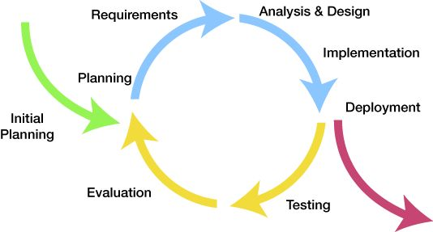
Project Management
プロジェクト管理
Software development process
ソフトウェア開発のプロセス
Iteration 1: May 08th – Aug 25th
Iterative Model
8

Slide 10
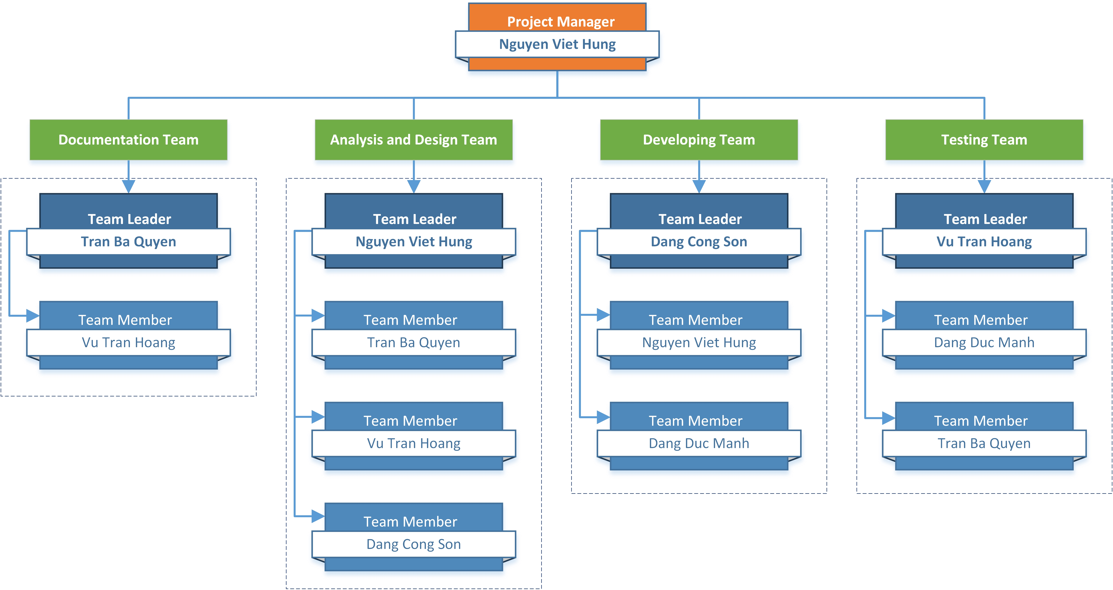
Project Management
プロジェクト管理
Organizational Structure - 組織構造
9

Slide 11
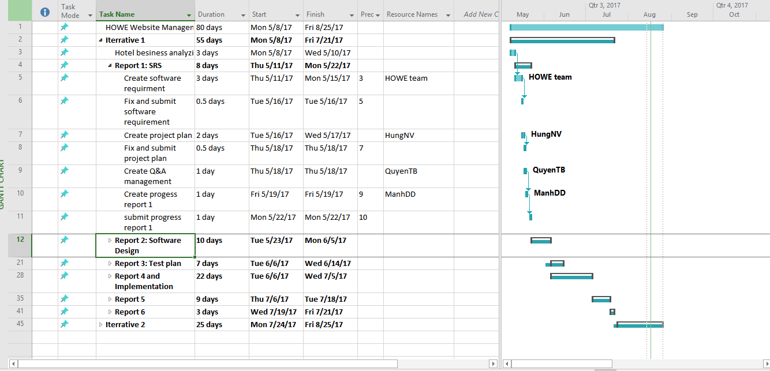
Project Management
プロジェクト管理
Project schedule - プロジェクトスケジュール
10

Slide 12





Project Management
プロジェクト管理
Tools & Infrastructure ツールと インフラストラクチャ
Tools for project management
11

Slide 13








Project Management
プロジェクト管理
Project Infrastructure - プロジェクトインフラストラクチャ
Tools for developing
12

Slide 14
Project Management
プロジェクト管理
Risk Management - リスク管理
No | Name | Root Cause | Probability | Avoidance plan | Contingency plan | Impact
1 | Project team don’t meet the deadline on time. | Members lack of responsibility Lack of management. | Medium | Make rules and penalties for member who didn’t meet the deadline. | Working overtime to complete tasks on time. | High
2 | Requirement changed while project is being processed. | SRS is not provide all information about user requirement such as: lack of customer’s requirement, misunderstand customer’s requirement. | High | SRS should be reviewed carefully by PM and Supervisor. Always do brainstorming carefully to design detail system. Hold all meeting and make minimize effort to change and improve design by requirement changes. | Team members will have meetings with supervisor to analyze the requirement changes, and make a specific action to resolve that problem. | High
13

Slide 15






Project Management
プロジェクト管理
Communication management - コミュニケーション管理
Time: 4 ~ 6 hours/day, 5 days/week.
Location: P505L Alpha building, room
Communication:
Meeting minutes:
14

Slide 16

SOFTWARE REQUIREMENT SPECIFICATION
ソフトウェア要件仕様書
15

Slide 17




Software requirement specification
ソフトウェア要件仕様書
27 use cases
Manager
Receptionist
10 use cases
8 use cases
Common
3 use cases
Guest
Accountant
5 use cases
1 use case
16

Slide 18
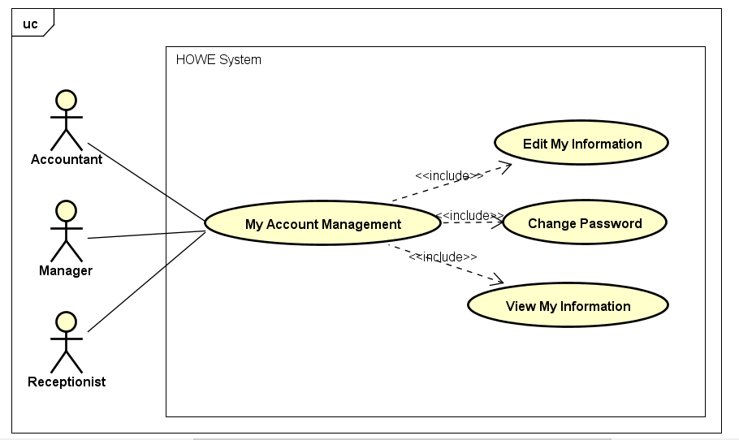

Software requirement specification
ソフトウェア要件仕様
Use Case Diagram
3 use cases
Common
Common use case diagram
17

Slide 19

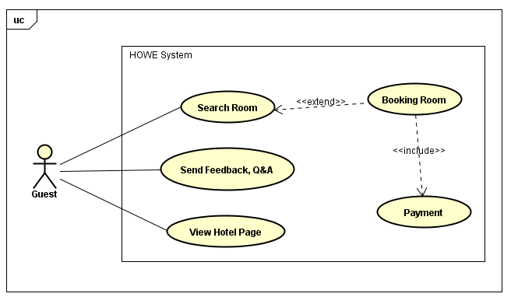
Software requirement specification
ソフトウェア要件仕様
Use Case Diagram
5 use cases
Guest
Guest use case diagram
18

Slide 20

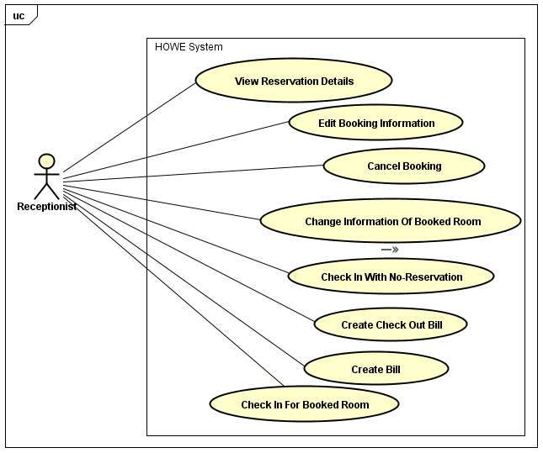
Software requirement specification
ソフトウェア要件仕様
Use Case Diagram
8 use cases
Receptionist
Receptionist use case diagram
19

Slide 21
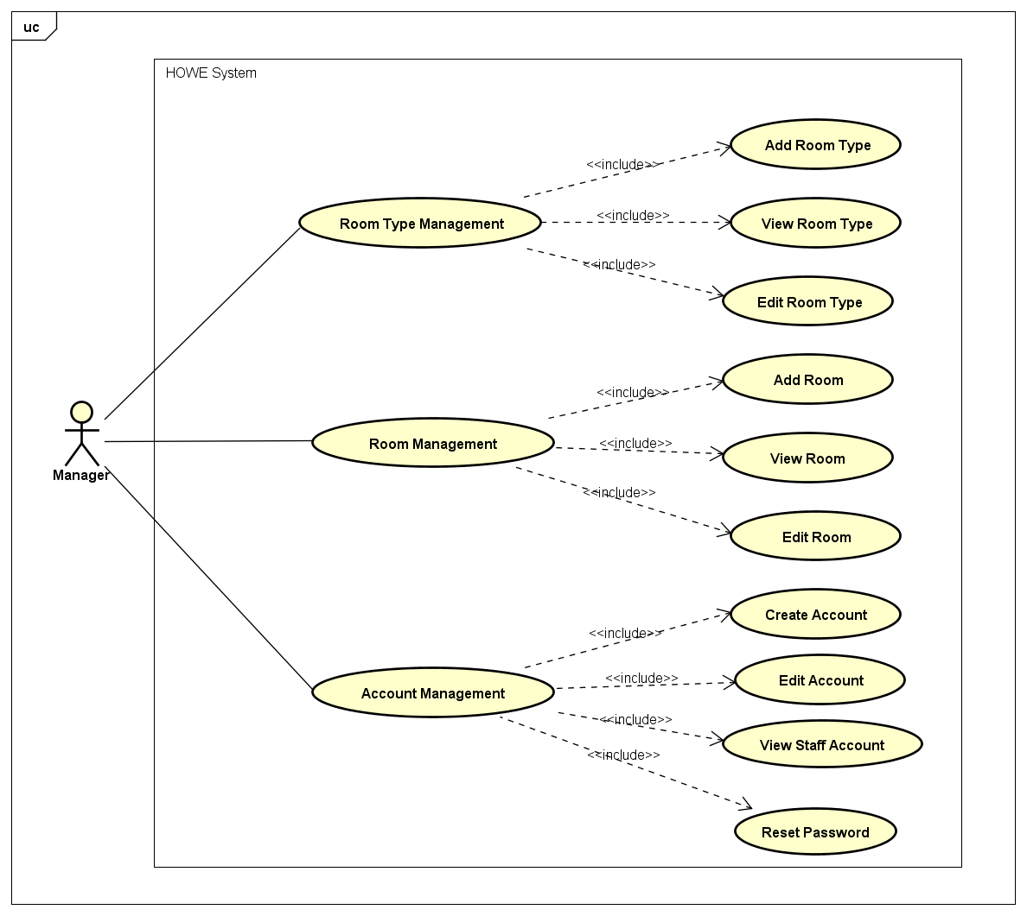
Software requirement specification
ソフトウェア要件仕様
Use Case Diagram
10 use cases
Manager
Manager use case diagram
20

Slide 22
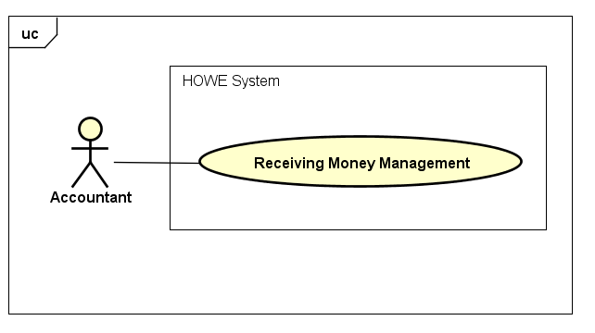
Software requirement specification
ソフトウェア要件仕様
Use Case Diagram
1 use case
Accountant
Accountant use case diagram
21

Slide 23
Software requirement specification
ソフトウェア要件仕様
Use Case ID: |  | UC025 |  |  | Version: | 1.0
Use Case Name: |  | Reset Password |  |  | Priority: | Medium
Created by: |  | HoangVT |  |  | Date Created: | 29/05/2017
Actors: |  | Manager
Description: |  | This function allows actor reset password of locked account
Trigger: |  | Click on “Quản lý tài khoản” on the management page
Extension UC: |  | UC023 – View Staff Account
Preconditions: |  | Account is locked
Normal Flow
No | Actor Events |  |  | System Response
1 | Click on “Đặt lại mật khẩu” button
2 |  |  |  | Display successfully message, display list of accounts form
Extension Flows
ET1 | At step 1 in the main flows, actor click on other button/link
No | Actor Events |  |  | System Response
2.1 |  |  |  | Display selected button/link page
Business Rules: |  |  | N/A
Other Information: |  |  | N/A
22

Slide 24
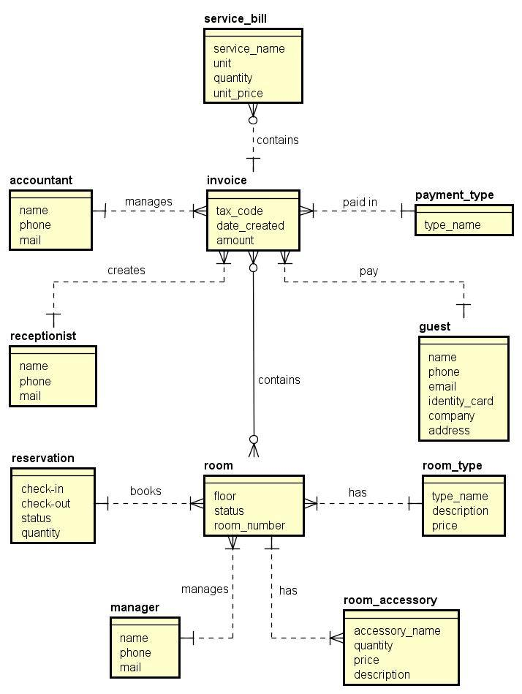
Software requirement specification
ソフトウェア要件仕様
23

Slide 25

Software requirement specification
ソフトウェア要件仕様
Non – Functional Requirement
Usability
Interface should be beauty, simple, easy-to-use, clear.
The short, easy steps make it easy for actor to interact with the system immediately after training.
Provide an introduction to support users.
24

Slide 26


Software requirement specification
ソフトウェア要件仕様
Non – Functional Requirement
SUPPORTABILITY
Easy to maintain.
The website deployment and upgrade will be specified in the Installation Guide documents.
DESIGN CONSTRAINTS
Default date format: YYYY/MM/DD (example: 2017/05/29)
Default time format: HH(24):MM (example: 22:07)
Decimal places only 1-digit (example 2.2)
Decimal places of ‘%’ is 1-digit (example: 23.4%)
Currency: !#,#.00 (! is currency symbol, # is one or more digit)
25

Slide 27
SOFTWARE DESIGN DESCRIPTION
ソフトウェア 設計書
26

Slide 28
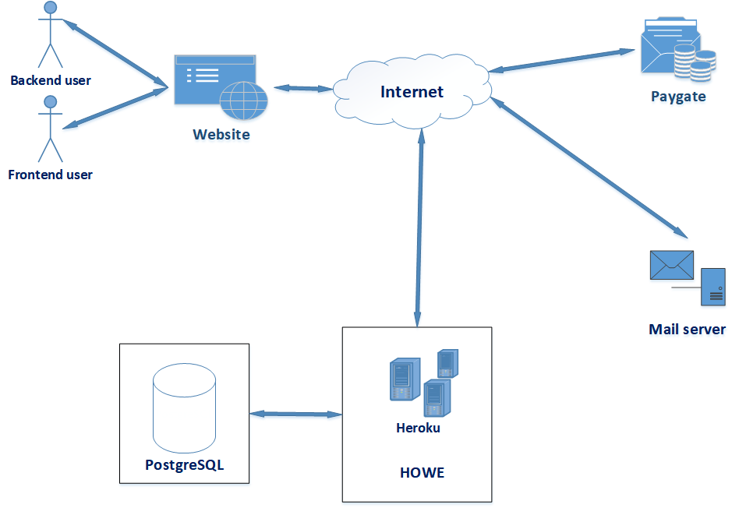
Software Design Description
System Architecture
27

Slide 29
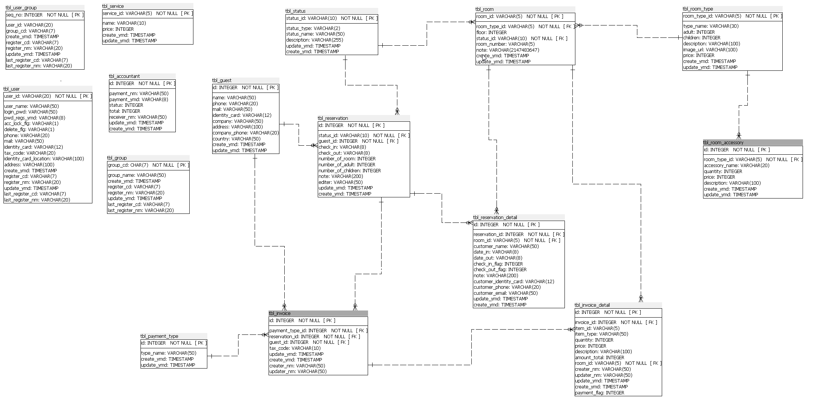
Software Design Description
Database
Design
28

Slide 30
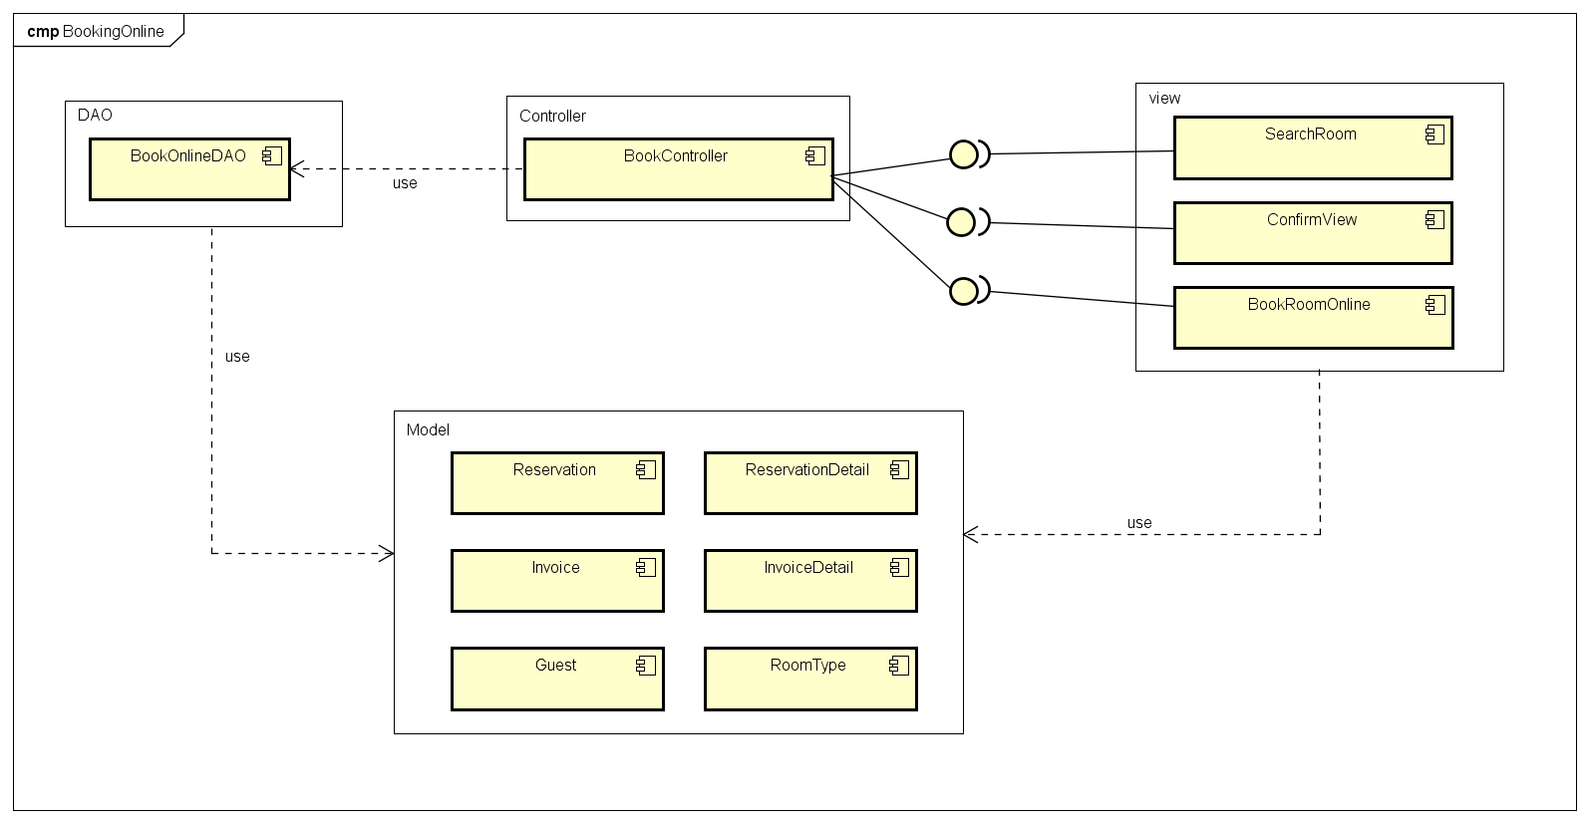
Software Design Description
Component
Diagram
Booking Online Component Diagram
29

Slide 31
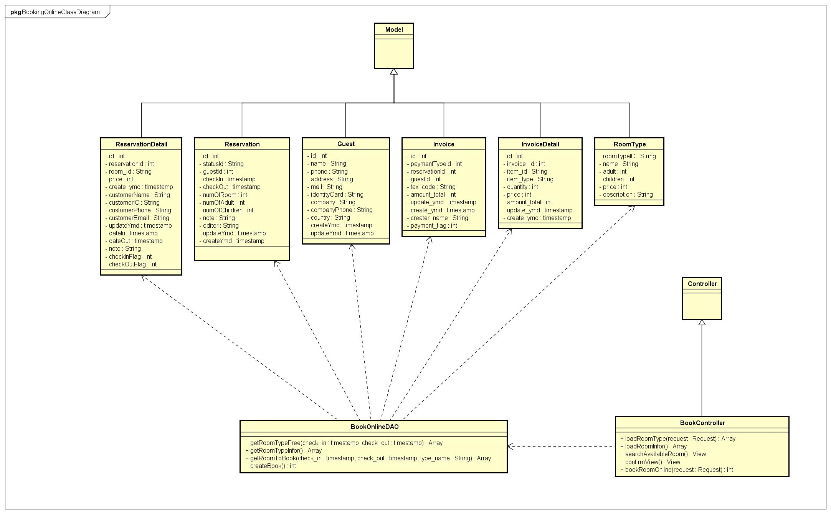
Software Design Description
Class
Diagram
Booking Online Class Diagram
30

Slide 32
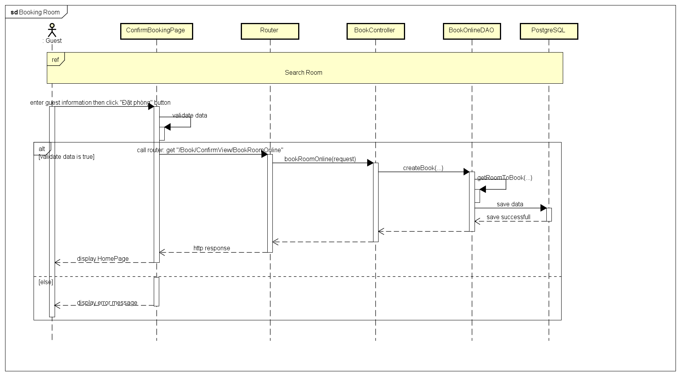
Software Design Description
Sequence Diagram
Booking Online Sequence Diagram
31

Slide 33



SOFTWARE TESTING
ソフトウェアテスト
32

Slide 34
Testing
01
Test Plan
02
Test Strategy
03
Test Process
04
PowerPointDep.net - website cung cấp các mẫu thiết kế hàng đầu về PowerPoint.
Test Cases
05
Test Report
06
33
Create Test Report

Slide 35
Testing
Test Plan
Base on Project Plan, Project Schedule, SRS to create Test Plan
Risks and contingencies
Features to be tested
Resources
Schedule
34

Slide 36



Test Environment and Tools
Testing
Microsoft Windows 10 Professional 64 bit
Google Chrome 60.0
Microsoft Office Word, Excel 2016
35

Slide 37
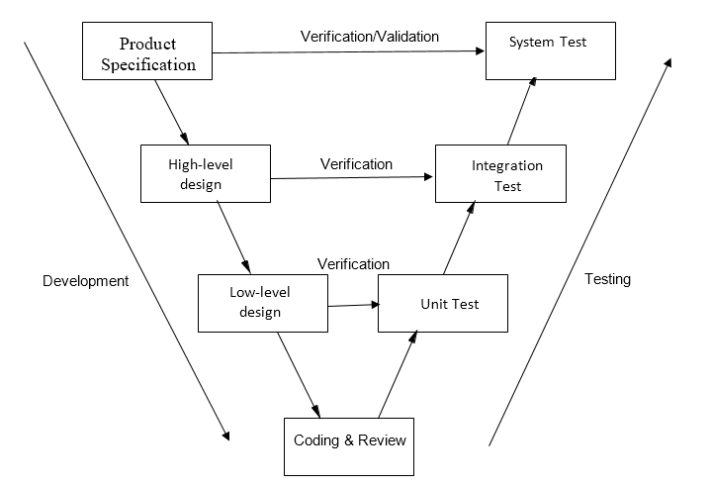
Testing
Test Strategy
V-Model
36

Slide 38
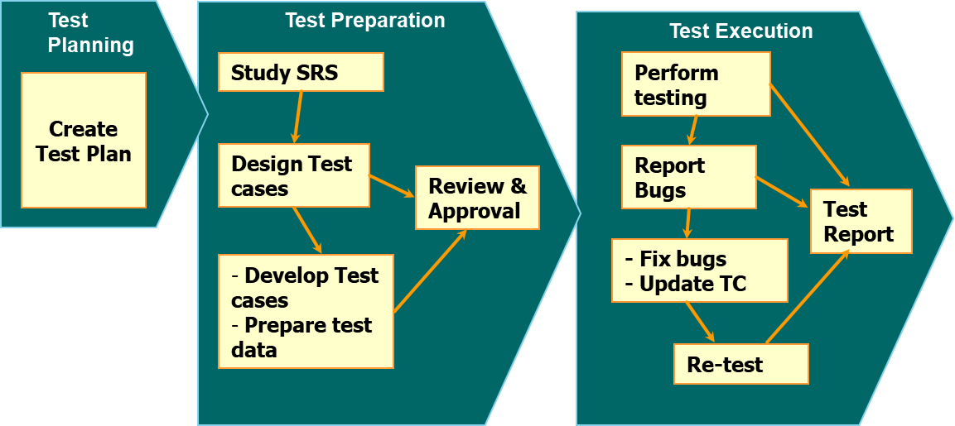
Testing
Test Process
FPT Software Testing Process
37

Slide 39

Testing
Test Case
01
Integration Test Case
02
System Test Case
38

Slide 40
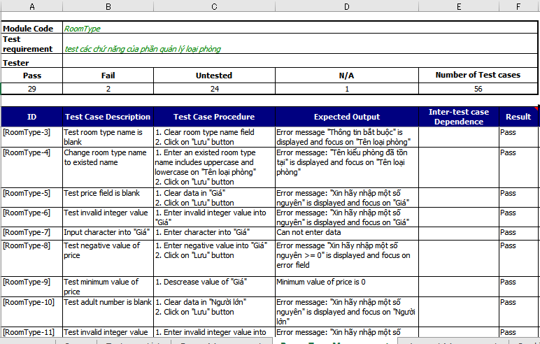
THIS IS A SLIDE TITLE
Testing
Test Case Sample
39

Slide 41
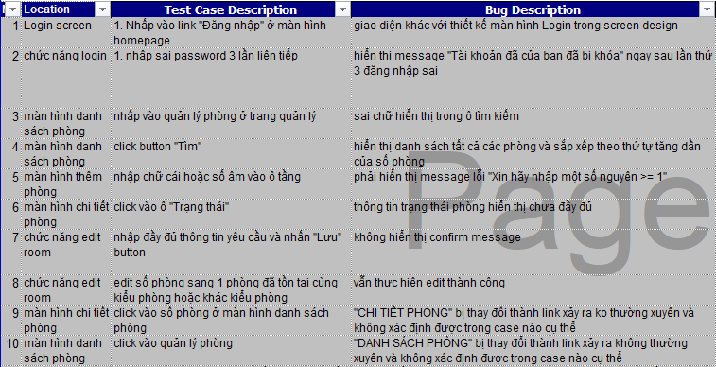
Testing
Defect bug
40

Slide 42
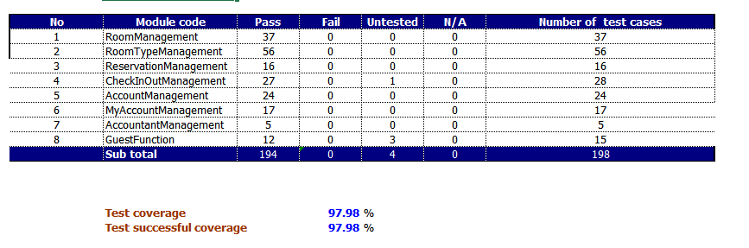
Testing
Test Report
Integration Test Report
41

Slide 43
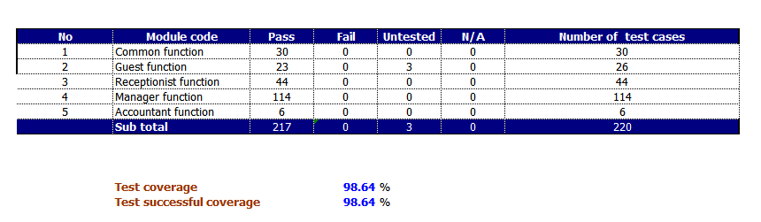
Testing
Test Report
System Test Report
42

Slide 44
LESSON LEARNED
教訓
43

Slide 45




LESSON LEARNED
Teamwork
Management Skill
Business Analysis
New Technology
44

Slide 46


DEMO
デモ
45

Slide 47
Q&A
質問と回答
46

Slide 48
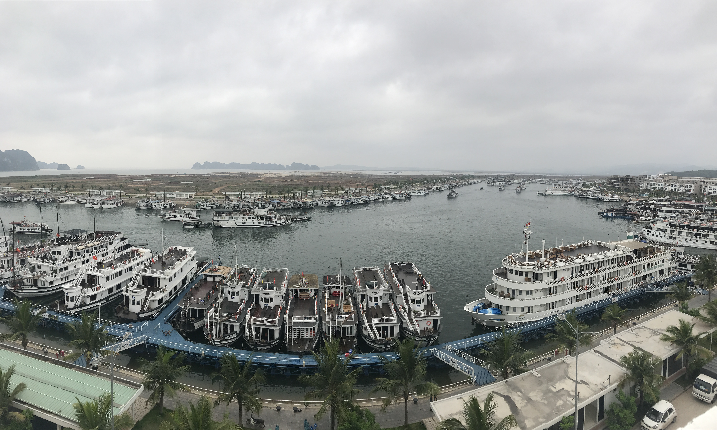
Thanks for watching!
ご清聴ありがとうございました。
48

